Slide 1
Browser-Based Application Multimedia Framework
ROBERT CONCEPCION iii
Csci-870 – m01
New york institute of technology

Slide 2
Traditional WebApps
Loading is Synchronous, yet Interface programming is asynchronous
Callbacks are commonplace, thus a wait for user input in order to call on other modules/functions.
AJAX and other such libraries perpetuate this design philosophy.

Slide 3
Synchronous Interactive WebApps
Not commonplace with in-browser libraries.
Typically workarounds via plugins such as Flash provide a ‘contained’ environment but provide security issues.
Various libraries taken together, no constant time/tracking of all entities by a controller.
Integration between input, animation and sound is left to the developer to synchronize.

Slide 4
Goals
Plugin-less
Efficient
Modular
Open Source
Mobile Ready

Slide 5
Technologies
HTML5 (Web Audio, Canvas, File)
CSS (+PureCSS)
JavaScript (+YUILibrary, JSZip, Misc)

Slide 6
Advantages
Minimal overhead - written in barebones JavaScript and HTML5.
Extensible; new modules can easily and flexibly be added for web app | functionality.
Simple & Consistent – handles Animation, Sound and Entity Logic with a clear design pattern.

Slide 7
Entirely Modular
Apps run within their own context on a page
The Framework can load only necessary elements; e.g. Keyboard Input & Graphics, Sound, separately.
New modules can be created and old ones can be extended or substituted
<DOM>
$canvas2
app1
app2
$canvas1

Slide 8
Require.js
Allows for modules using Asynchronous Module Definition(AMD).
Allows for dependency injection; interdependent modules.
New modules can easily be created by the open source community
Smaller HTTP Requests

Slide 9
Require.js(cont’d)
<script src=‘../js/module1.js’></script>
<script src=‘../js/module2.js’></script>
<script src=‘../js/module3.js’></script>
becomes . . .
<script data-main=‘../js/threejs_test’ src=‘../js/require.js’></script>

Slide 10
AMD Pattern
require([‘src1.js, src2.js, …’], function(Src1, Src2, …) { Src1.moduleFunction(); }
newmodule.js
define([‘dependency1.js, d2.js’], function(Dpc1, Dpc2) { ...

Slide 11
Modules Provided
BAMF(‘bamf/bamf.js’)
Canvas2D(‘bamf/canvas2d.js’)
Canvas3D(‘bamf/canvas3d.js’)
Audio(‘bamf/audio.js’)
Key(‘bamf/key.js’)
Mouse(‘bamf/mouse.js’)
Angle(‘bamf/angle.js’)*
Collision(‘bamf/collision.js’)*

Slide 12
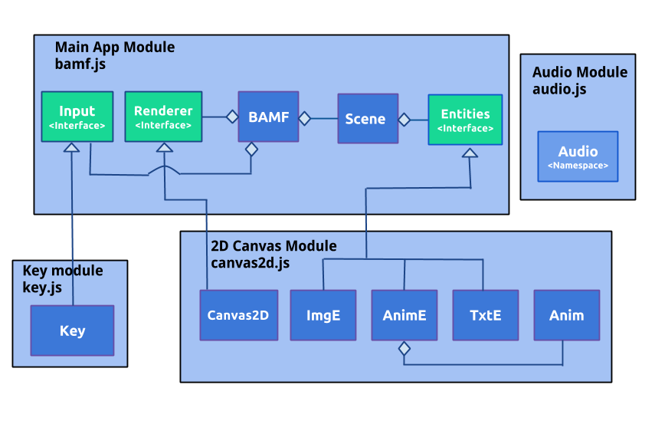
Framework Architecture
Framework Overview

Slide 13
Animation Editor/Source Generator
Utility which allows a developer to edit animations easily to import into their apps as these are fundamental to web apps and traditional sites alike.
Works on all browsers, no plugins
Ability to save/load image data for returning
Preview your animations

Slide 14
Documentation - JSDOC
Allows for convenient view of all methods, functions and relationships that developers should know
Comments in code generate the document
Flexible, support for modules
Documentation must be explicitly defined (+)

Slide 15
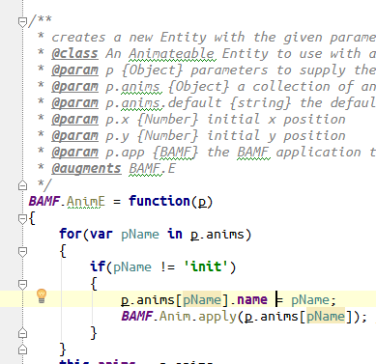
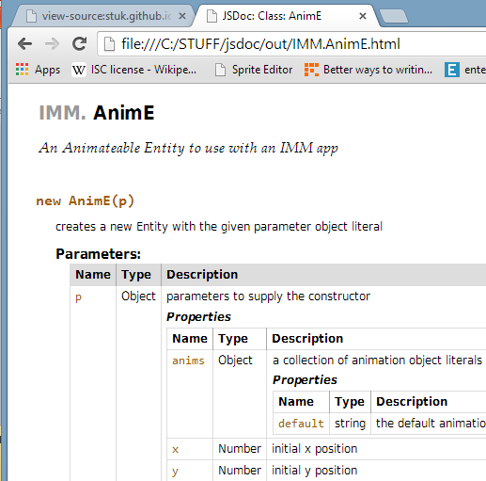
Documentation - JSDOC

Slide 16
Future Work
SVG Rendering
Three.js Entities, Lights, Etc.
New Input Methods such as LEAP using sockets
Efficiency

Slide 17

Thank you for your time!
Questions?... Comments?
Open Source, download at:
http://www.github.com/rob2d/bamf

